Slide 1


Teaching Pathologists
How To Code
How to Fix the Data Literacy Crisis in Medical Education
Stephan Kadauke, MD, PhD
Amrom Obstfeld, MD, PhD
July 27th, 2021
APC Annual Meeting
Notes:
Thank you so much for the kind introduction! I’m super excited to be here today. Thanks for inviting me.
My name is Stephan Kadauke, and I’m an Assistant Professor of Pathology at the Children’s Hospital of Philadelphia. I work in the Divisions of Transfusion Medicine and Pathology Informatics.
I’m joined by my friend and colleague Amrom Obstfeld, who is also an Assistant Professor of Pathology at CHOP, and serves as the Medical Director of Pathology Informatics.
And today, we are going to try to convey some ideas about how we should do data analysis and teach data analysis that may seem aspirational, but are actually grounded in practices that are emerging and may soon be standard both in academic research and in clinical operations.
And by the way, you don’t have to take any notes, at the end of the lecture we will provide you a link to a web site that has the slides and all other materials and references. Also, this is an interactive session – so please feel free to write your questions in the chat, and Amrom will be answering them. Also, I will be asking a few Your-Turn type questions and ask you to write answers in the chat, just to make things a bit more engaging.

Slide 2
Disclosures
None relating to anything I will be talking about today.
Notes:
I have no disclosures relating to the topic I’m discussing today.
I will be talking about some of the products made by a company called RStudio, however all of the products and packages I will discuss are freely available and open source. I have no financial interest in RStudio.

Slide 3
Assumptions
You are a pathologist (perhaps in training).
You have or will have a professional responsibility to read, work with, analyze, and argue with data for clinical, operational, and/or research purposes.
You have used Microsoft Excel for analyzing data.
Notes:
For today’s session I assume that you are a clinician, more specifically a pathologist, possibly in training.
(**) I will also assume that you have or will at some point have a professional responsibility to …
(**) And I will also assume that you all have worked with Microsoft Excel, or some other kind of spreadsheet software, and therefore have at least a passing familiarity with it.

Slide 4
Objectives
Explain why analyzing data with Excel can limit data literacy and compromise data quality that may lead to patient harm
Describe key features of a reproducible workflow for data analysis
Learn how to compose a basic computational document written in R Markdown
Notes:
And my goal is that after my section of the talk, you will be able to…
(**) explain why analyzing data with Excel, or similar spreadsheet software, can limit data literacy and compromise data quality, and may ultimately lead to patient harm.
(**) you will also be able to describe some key features of what I will call a ”reproducible workflow” for data analysis
(**) and finally, you’ll be able to define the term “computational document”, which is a key ingredient of reproducible workflows, and if the technology plays along today, at the very end, we'll do a quick exercise in which we’ll put together a document written in R Markdown, which is the type of computational document that we use at CHOP.
So this is going to be an interactive session ((and it's a small group so feel free to unmute and ask questions if something's unclear.)) And no worries about the exercise I just mentioned, you don't have to install anything on your computer. I’ll post a link in the chat to a web-based environment I've set up for us to play with R Markdown.

Slide 5
Data Literacy and Excel

Slide 6
Data Literacy Skills
Reading data
Understanding data, graphs, and statistical summaries
Working with data
Acquiring data from various sources in various formats
Data entry, cleaning and validating
Storing data
Collaborating with others
Analyzing data
Transforming data
Visualization
Creating summary tables
Statistical modeling
Arguing with data
Using data to communicate some message to an audience
Creating reports that can tell a compelling story
* D’Ignazio, Bhargava, J Comm Informatics 2016
Notes:
Since we’ll be talking about Data Literacy, I want to start by defining ”Data Literacy.” There are a number of definitions out there, but I like the one proposed by Catherine D’Ignazio and Rahul Bhargava, which is that “data literacy includes the ability to read, (**) work with, (**) analyze, and (**) argue with data as part of a larger inquiry process.”
Each of these four core domains comprise a set of skills.
For example, for reading data, you need to be able to understand where the data are coming from, how graphs are constructed, and what the meaning of key statistical summaries are.
To work with data efficiently, you have to be able to acquire data from various sources in various formats. You should not only know how to enter data, but also how to set up data entry to minimize errors, and you need to be able to clean up manually entered data. You should also be able to come up with a workflow that allows you to collaborate with others.
Analyzing data includes transforming data from one shape to another, visualization, creating summary tables, and basic statistical modeling.
And arguing with data includes effectively communicating some message to an audience by creating reports that can tell a compelling story.

Slide 7

Excel bills itself as an all-in-one solution…
Data entry
Data storage
Visualization
Calculations
…but it is not great for any of these.
Higgins, Tidy Spreadsheets in Medical Research, 2021
Notes:
Excel bills itself as an all-in-one solution, sort of a swiss army knife for (**) data entry, (**) data storage, (**) visualization, and (**) creating calculations and statistical summaries.
(**) The reality is though that Excel is not great at any of these tasks. It’s possible to create a workflow that mitigates some of Excel’s shortcomings - for an overview, I highly recommend (**) Peter Higgins’ lecture on “Tidy spreadsheets in Medical Research”, and I’ll provide the link to the YouTube video at the end of the session.

Slide 8

Notes:
Instead of a swiss army knife, I like to think of Excel as more like training wheels for a bike. And parenthetically, this is personal for me because it took me a long time to learn how to ride a bike with training wheels.
Be that as it may, there are a couple of proven upsides to training wheels. They get you started riding at an earlier age and they do remove some of the frustration when you first get started. They keep you upright and protect you from falling over.
HOWEVER:
If you use training wheels, you don’t learn to balance, and you don’t learn to steer with your body. So they encourage some really poor habits which is counterproductive; and these poor habits can be difficult to unlearn if you want to graduate from using training wheels and learn to really ride a bike.

Slide 9
Notes:
This is similar to Excel. There are some upsides, but really only in the beginning. With Excel, you just open the program and can get going, typing in some data and doing some calculations. And Excel protects you from confusing errors, it just lets you do whatever you want without complaining.
HOWEVER:
Excel encourages poor habits: it mashes together data entry, data storage, and data analysis, which should really be separate concerns and activities.
It encourages you to encode data as colors, which makes for beautiful spreadsheets but is poor practice since that information is usually lost when you export or extract data from Excel.
It lacks features that would make it easy to collaborate with others; to work with data that change; to work with large data; or to work with sensitive data.
It gets worse though: Excel causes errors and doesn’t warn you in situations that are likely to cause errors. It makes it easy to overwrite data or formula fields by mistake. It silently autocorrects gene names to dates and drops rows if you have a huge dataset.
But perhaps most importantly: Excel encourages a data analysis workflow that is fundamentally not reproducible, which is a point that I’ll go into a bit more in the next section.
But for now, to drive home the analogy: Training wheels don’t really help you learn how to ride a bike. And working with Excel doesn’t really help you become data literate. And if you want to teach data literacy, you may have to get your students to unlearn some poor habits.

Slide 10
Reproducibility and Excel

Slide 11
Replicability
Reproducibility
Can someone else rerun the study and get the same result?
Collect new data
Difficult
Scientific gold standard
Can someone else exactly repeat the analysis?
Use the same data
Easier
Proposed as a minimum standard*
* Peng, Science 2011
Notes:
In this section of the talk, I’m going to argue that *reproducibility* is a key principle of an efficient data analysis workflow and therefore key for data literacy. For that reason, I’d like to start by defining *Reproducibility*, by contrasting it with the related but distinct concept of *Replicability*.
(**) Replicability is the extent to which the findings of a study are generalizable, meaning that someone else can re-do the entire study and get the same result and come to the same conclusions.
So what people sometimes call the reproducibility crisis, where Amgen, Bayer, and others reported that they often can't confirm the results of landmark studies is more precisely a replicability crisis, or replication crisis.
(**) So for replication you need to collect new data, (**) which is often difficult or at least time-consuming.
(**) Replication is the scientific gold standard for the validity of a study.
In contrast, reproducibility is the extent to which you can exactly repeat the data analysis, meaning that someone else can take the same data and get the exact same result.
(**) So for reproduction you use the same data, which makes this much (**) easier to do than replication.
(**) It’s important to be aware that reproduction does *not* show by itself that the study is valid because there could be problems with how the data were collected, AND there could be errors in the analysis itself.
Reproducibility has been proposed as a (**) minimum standard for the scientific validity of a study. The reason is that having a workflow that’s not reproducible can be dangerous because it makes it hard to spot errors in data processing. I next want to look at a case study that illustrates this point.

Slide 12
18
The Duke Cancer Scandal
Chemo sensitivity from microarrays
Errors first, then cover-up
Clinical trials based on flawed models
Papers retracted, lawsuits settled
Notes:
In the mid-2000s, Anil Potti and Joseph Nevins of Duke University tried to predict sensitivity of tumor cells to chemotherapeutic agents using microarray gene expression data. These were some of the first papers that used microarrays for “personalized oncology” and so they generated a lot of excitement at the time. These papers got published in high-profile journals including Nature Medicine, JAMA, and the New England Journal.
(**) Unfortunately, there were a number of serious errors in the data analysis. The media has focused on the fact that the researchers tried to cover up investigations into these errors and press on towards clinical trials even though there were at the time open questions about the validity of their methods.
(**) Even more unfortunately, 110 patients were enrolled in 4 clinical trials and allocated to chemotherapy treatment arms based on flawed models.
(**) In the end, 18 papers were retracted, and Duke settled a number of lawsuits for an undisclosed amount of money.

Slide 13
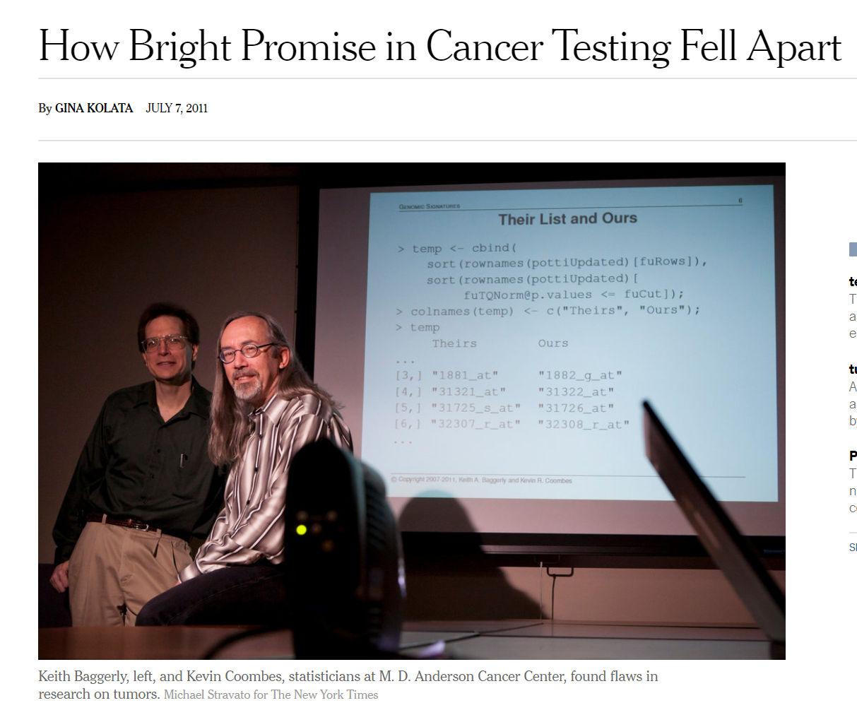
Notes:
So how did this all get uncovered?
When the Duke Cancer papers started coming out, investigators at other institutions were keen to use these methods for their own research questions. And a first step that researchers will often take is to independently reanalyze the data from a published study to see whether they get the same results.
And two of these researchers were Keith Baggerly and Kevin Coombes from MD Anderson.
So they started with the raw data, which was deposited in a publicly available repository, and then they tried to follow the steps outlined in the paper, but they got completely different results. They tried to resolve this with the authors published studies but when they heard that clinical trials were being initiated that used these questionable models, they started an effort to forensically uncover why they were getting incorrect results.

Slide 14
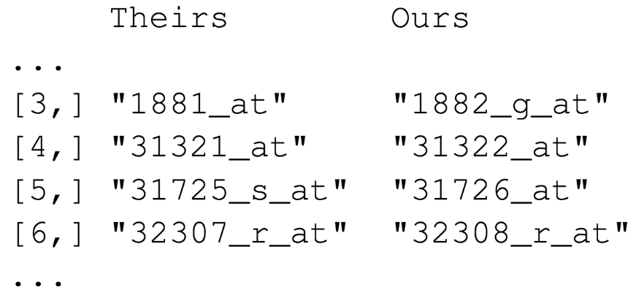

Duke
MD Anderson
Off-by-one indexing error
Notes:
The MD Anderson team was able to reconstruct a number of errors that explained the incorrectly reported results.
And here is one of the errors they found in one of the main data sets.
These are a few of the hundreds of microarray probe sets – each one corresponds to a gene – that the Duke investigators reported to predict sensitivity to 5-fluorouracil.
(**) And here are the probe sets that the MD Anderson team got. You can see that those two are different.
(**) If I highlight the last number of each probe, you can appreciate the pattern… does anyone see the pattern? Type your answer in the chat! …
The pattern is that the number of the probe set that Duke reported is exactly one less than the number of the probe that MD Anderson found.
(**) This is what’s called a off-by-one indexing error and is what happens when you copy and paste values from Excel one column at a time, and in one of the columns you grab the wrong starting row, and as a result all the values in the affected column are shifted by one. This is a simple error to make, but as you might imagine, this error completely invalidates all downstream results.

Slide 15
“Common problems are simple…
Off-by-one indexing error
Sensitive / resistant label reversal
Identical data shown more than once
Batch effect
Wrong heatmap shown
… and simple problems are common.”
Notes:
The off-by-one indexing error was just one of many simple errors the MD Anderson team discovered.
Another type of error that was pervasive in the study was label reversal. Why do you think a label reversal error might be particularly heinous if used in a clinical trial? Type your answer in the chat! …
In more than one case, a cell line that was labeled as “sensitive” to a chemo drug was actually resistant, and vice versa. That type of error can lead to a scenario where a patient gets the chemotherapy that would be predicted to be least beneficial.
These are all simple errors – you don’t have to be incompetent or negligent to make them. (**) And because they’re so easy to make, and without good documentation or a reproducible workflow it’s hard to catch them, they are also very common.

Slide 16
Point-and-click tools are usually not reproducible
Notes:
(slow!) One of the main takeaways from this case study is… that a critical barrier to reproducibility is the tendency of investigators to use graphical user interface “point-and-click” type tools, like Microsoft Excel.
(**) Point-and-click type tools are usually not reproducible, because they don’t record user actions.

Slide 17
Your Turn #1
Which one of the following statements is NOT true?
An off-by-one indexing error commonly occurs when a workflow requires copying columns from Excel and pasting into another application.
Label reversal errors commonly occur when a categorical variable is expressed as numbers (e.g., “0” and “1”) instead of names (e.g., “sensitive” and “resistant”)
Reproducibility has been proposed as a gold standard for scientific validity.
Both B and C
A
B
C
D
Notes:
Let’s do a quick Your Turn. I’ll read the prompt for you and will then ask you to type the answer in the chat! …
Test:
Understand mechanism of off-by-one indexing error
Understand mechanism of a label reversal error
Distinguish replicability vs reproducibility
C – correct.
A – confused replicability vs reproducibility AND does not understand the mechanism of an off-by-one error
B – confused replicability vs reproducibility AND does not understand the mechanism of a label reversal error
D – does not understand the mechanism of a label reversal error

Slide 18
Reproducible Data Analysis Workflows

Slide 19
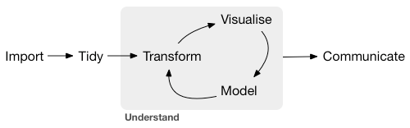
Data analysis life cycle
Define Objective(s)
Identify Data Source(s)
Wickham and Grolemund. R for Data Science (2017)
Notes:
Before we look at *reproducible* data analysis workflows, let’s create a conceptual model of a typical data analysis project. And this could be a research project or clinical operations, could be anything. By the way, it’s no coincidence that these activities strongly overlap with core data literacy skills.
You begin by roughly defining the goals and objectives of the project (**) and identify what data you need to meet these goals.
(**) Then you then import the data, which means bringing it into your your analytics software in some way.
(**) Then you tidy the data – by which I mean reshaping it for analysis and also performing data quality control.
(**) Usually the next step will be to transform the data in some way in order to prepare it for a specific analysis, perhaps filtering out patient visits from a specific year or hospital unit or combining two data tables, maybe one has treatments of interest, and the other one has outcomes of interest. Could be any number of things.
(slow) The two main engines of knowledge generation are visualization and modeling.
In a typical data analysis, transforming, visualizing, and modeling happens not only once, but over and over. This is what’s called the Understand cycle. The quality of the analysis depends on whether that cycle has been iterated a sufficient number of times to address the question that you're asking. For some things you really only have to go through this once or twice, but for example for building machine learning models you might have to do this many, many times.
(**) The final critical piece is communication of the insights in such a way that they eventually get turned into action. And that could be through a publication, a report to a stakeholder, or some other way so that the analysis can be used for decision making.

Slide 20


Domain expert
Technical user
Notes:
Now data analysis often happens as a collaborative effort. Usually, you have some sort of a domain expert – in the hospital this could be an attending or a lab director – and a technical user – which could be an analyst or a technologist, or often times a trainee. And sometimes the one person plays both of these roles.
But for the sake an an example, let’s say that you have a blood bank director who asks an analyst to compose an audit of last year’s transfusion reactions.

Slide 21

Traditional workflow
Define Objective(s)
Identify Data Source(s)
Notes:
So the director might send a list of patients who have had transfusion reactions to the analyst, (**) and often times that list will be an Excel sheet. The analyst then goes through the list and might manually add columns with relevant data, creating their own version of the sheet.
(**) This effectively creates a silo that the domain expert has no insight into, and as we’ve seen errors will likely be made in this silo that will be hard to spot because we’re using Excel which doesn’t record user interactions.

Slide 22

Reproducible workflow
Define Objective(s)
Identify Data Source(s)
Notes:
Imagine that instead, you could eliminate Excel from the intermediate steps of data analysis and have the lab director and the analyst work together on a single document. And now also imagine that this document precisely and unambiguously lists the data sources and all the data analysis steps that need to be performed to turn raw data into visualizations and summaries.
This reproducible workflow would allow closer collaboration, more transparency, and also save time by catching data problems earlier, and more rapidly iterating through the analysis by eliminating much the back and forth spent in trying to communicate what was technically done rather than reviewing the results.
This workflow is made possible by adopting a new tool known as the “Computational Document”.

Slide 23
A computational document is a document that contains executable computer code.
Notes:
(slow) A computational document is a document that contains executable computer code.

Slide 24



R
Programming language for
data analysis
R Markdown
Computational document format
(uses R for executable code)
RStudio
Editor for writing
R Markdown
Notes:
Before I show you what a computational document looks like and how it fits into a reproducible workflow, let me introduce 3 terms that may or may not be new to you.
The first is R. R is a programming language for data analysis. There are lots of things that make R our preferred language at CHOP: it is freely available, makes it easy to wrangling complex data sets, and can produce publication-quality visualizations. Also, you can use R to pull data from any of the databases that are being used at CHOP, such as Epic, our lab information system, and our clinical data warehouse.
There is also an open and welcoming community of people who use R, as well as a relatively large R user base in pathology and lab medicine thanks to efforts by MSACL, API, and AACC.
And doing basic data analysis with R is actually not that difficult to learn, even if you’re not a computer programmer and have never written a single line of code.
(**) Then, there’s R Markdown. R Markdown is a computational document format that has executable code usually written in R. I say usually because it’s actually possible to write code in Python and other languages inside of an R Markdown document, if that's what you want to do.
(**) Finally, there’s RStudio. RStudio is the name of a company and also the name of a piece of software this company makes and makes available for free. You can think of RStudio as a fancy editor for writing R and R Markdown. You can run RStudio on Mac or Windows, or, if you’re concerned about protecting patient data or intellectual property, it’s possible to lock down an RStudio server behind the hospital firewall.
By the way, if you're interested in installing R and RStudio on your computer after today, I put links for this on a website we made for this session, and I’ll share this at the end of the session.

Slide 25
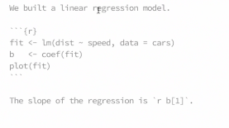
Better to show an example of an actual report, like this?
Notes:
An R Markdown document is a regular text file that has “marks” to add styling. For example, here we see one or two of hashtags at the beginning of a line. These hashtags tell R Markdown: this is a level one or a level two header.
Similarly, the asterisks at the beginning of the line signify bullet points.
A key idea is that you can convert, or “knit”, an R Markdown document into a final target format for viewing. (**) And here’s what the R Markdown on the left would look like converted to HTML. And HTML is the format that web browsers use, and it's the default target format of R Markdown.
So, R Markdown is a computational document format. So anybody can tell me what else should we be able to include? Type in the chat! …
Exactly! We should be able to include executable computer code. And I promise, I’m going to write a question for the American Board of Pathology, that’s going to ask exactly that, and now you know the answer.
(**) So you can add computer code to R Markdown in what’s called a code chunk. This code here – I’m only showing it to illustrate, don't worry about how it works – is some R code that generates 100 normally distributed random numbers and assigns them to a variable called x. And then calls the summary function on x.
As you can see, in the rendered document the code chunk is placed neatly in a gray box to make it visually distinct from the marked up narrative text.
(**) R Markdown also runs the code and shows the result right below the code. This way, you get a neatly formatted report that shows the code and the results of the code right below any text you might write to explain what the code does and why you've written it the way you did.
(**) You can also include plots and other graphical elements. Here we’re running the hist function on x, and the rendered document shows a histogram of the values in x.
Let’s do a quick demo to see what this would look like if you had R installed on your computer.
***DEMO 1
- Create R Markdown doc
- Change some text: Hello UAMS!
- Knit to HTML
- Knit to PDF

Slide 26
R Markdown for reproducible workflows
Define Objective(s)
Identify Data Source(s)
Notes:
We use R Markdown as the substrate for reproducible data analysis workflows. You can imagine the blood bank director and analyst collaborating on a single R Markdown document that contains all of the code to load the initial data, make data transformations, and create summary tables and graphics for the audit.

Slide 27



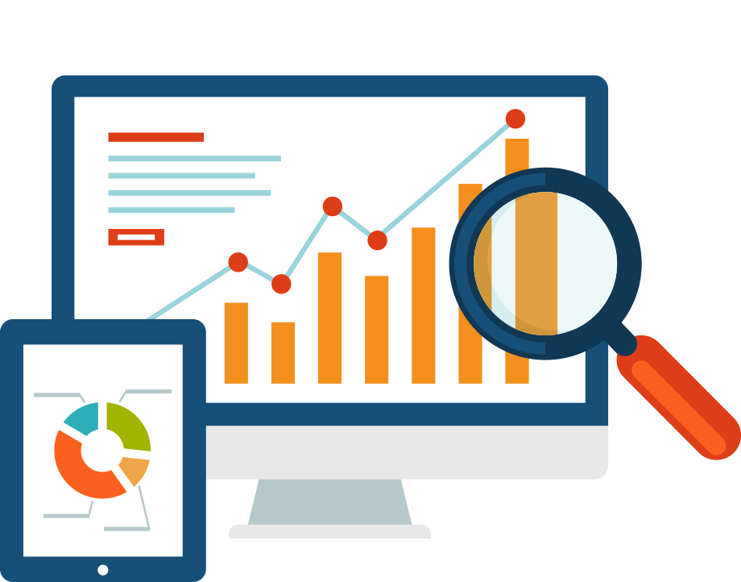

Notes:
One key feature of R Markdown is that you can “knit” R Markdown documents into a lot of different target formats, such as (**) HTML, (**) PDF, but also (**) Microsoft Word, and (**) PowerPoint. And even (**) interactive dashboards.

Slide 28


Deploying R Markdown Dashboards
shinyapps.io (free)
Shiny Server (free)
Notes:
The way this works is that your R Markdown document gets knitted into an HTML file, as I've just shown you, but then it uploads that HTML file to a server that makes it available to the internet or alternatively, your internal private network.
You can deploy your dashboards either in the cloud or on premise. If you want to deploy a dashboard that’s public-facing and doesn’t show any sensitive data, there is a free service called Shinyapps.io.
For internal-facing apps that may contain sensitive data you can use Shiny server, which is free.

Slide 29
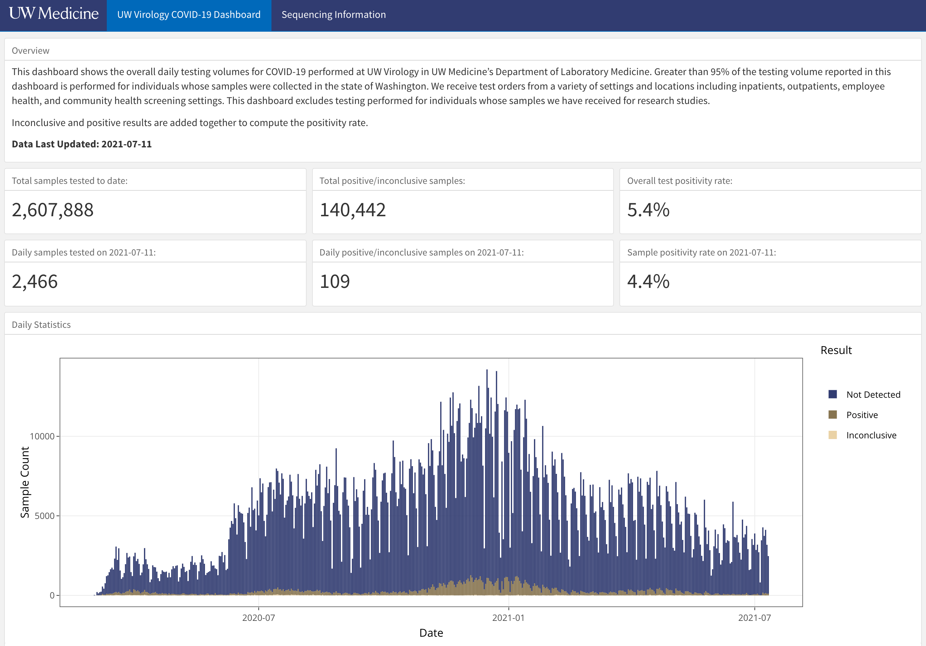
Notes:
Dashboards are a great way to communicate results because they display key data on demand, and they are increasingly being used by clinical laboratories, like for example this COVID19 testing dashboard of the University of Washington Lab Medicine Virology lab.
This dashboard is written in R Markdown, but you don’t need to know any R to use it. You just point your browser to its web site, and then you can see at a glance some key performance indicators, such as total samples tested to date, which as of two weeks ago is a whopping 2.6 million; and other numbers such as test positivity rate, daily positives, and so on.
In addition, there's a histogram of test volume over time, color coded by result. What I can’t show here because it’s a PowerPoint, is that the histogram is actually an interactive plot that lets me zoom in and get more detailed information by hovering over specific bars.

Slide 30
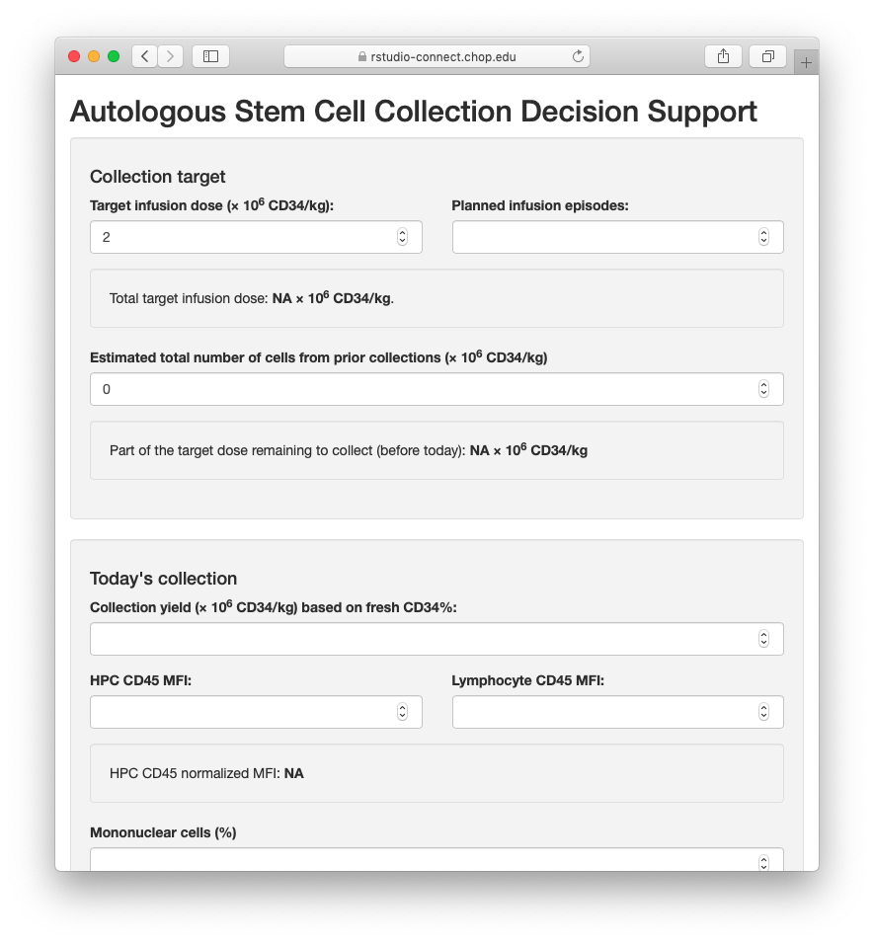
Custom-build the last 10% of your LIS
Notes:
One area where R Markdown powered dashboards shine is when a lab information system provides 90% of the necessary functionality, and you need to custom-build the remaining 10%.
Here’s a dashboard we created to support the bone marrow transplant physicians in deciding whether or not a stem cell collection is complete or more stem cells need to be collected the next day, by implementing a predictive algorithm that takes into account specific clinical and lab data. We’re still in testing, but I think this will eventually reduce the number of unnecessary stem cell collections significantly.

Slide 31

Notes:
I really believe that that knowing just a little bit of coding, especially with R and R Markdown, is really powerful if you’re a lab leader. Because then you can take more effective ownership and be actively involved in developing and implementing these kinds of tools.

Slide 32
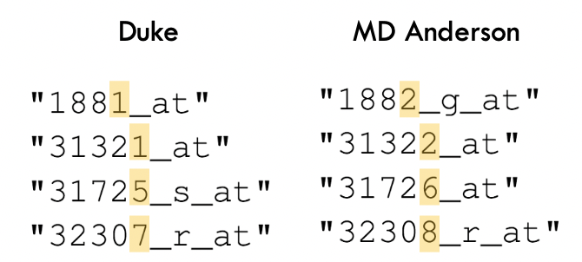
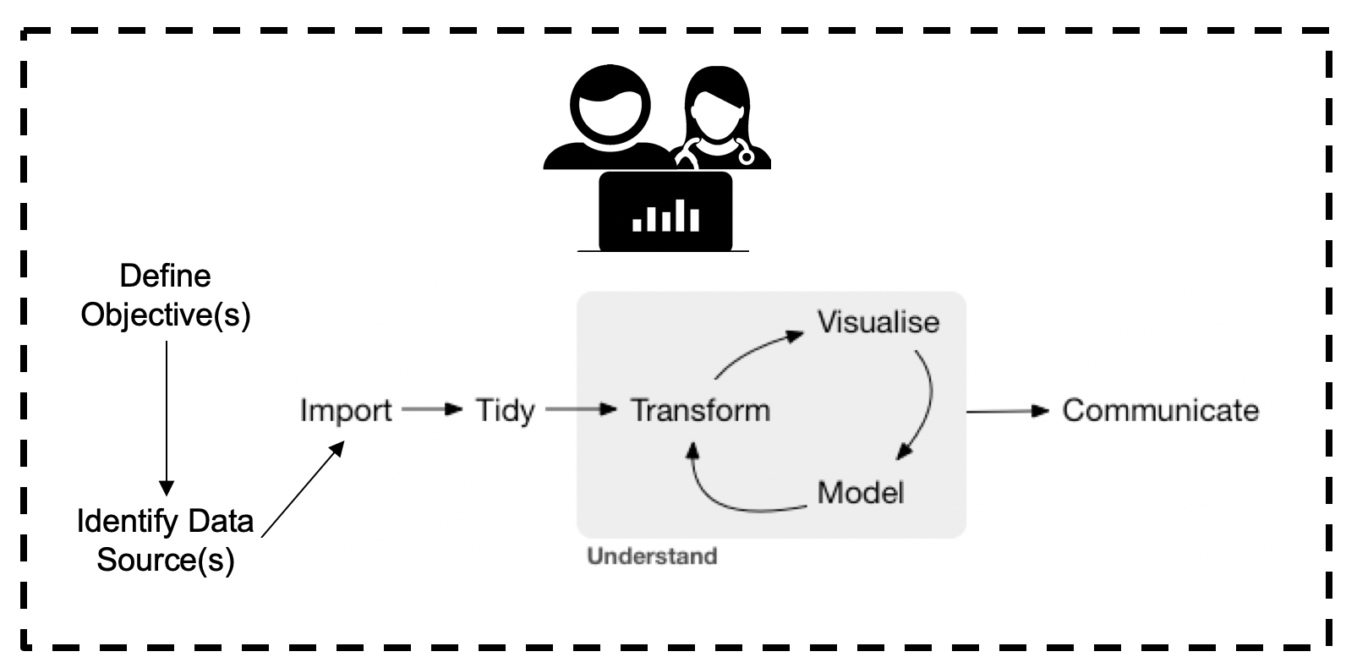
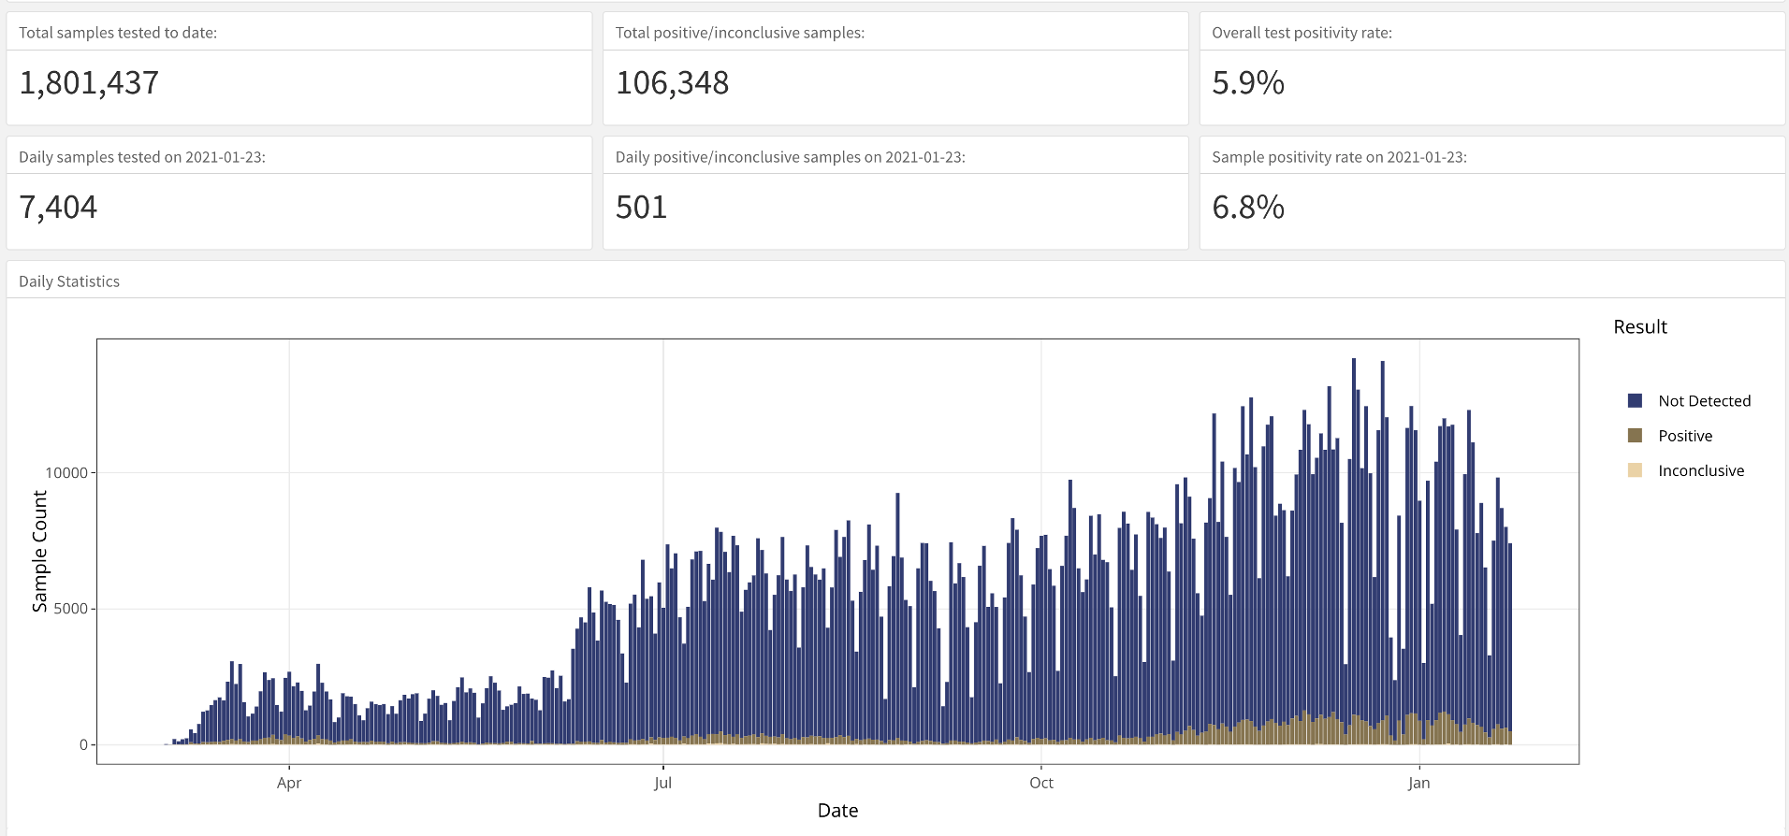
Recap
Analyzing data with Excel can compromise data quality that may lead to patient harm.
A reproducible workflow, in which the entire analysis is automated with computer code, can improve confidence in the validity of an analysis.
The computational document is a key ingredient of reproducible workflows. R Markdown is computational document format commonly used in lab medicine.
Dashboards can support lab operations and can be built in R Markdown. Knowledge of R Markdown can help lab leaders build more effective dashboards.
Notes:
To recap, …
(**) Analyzing data with with Excel, or similar spreadsheet software, can compromise data quality, and may ultimately lead to patient harm. This is because Excel does not record user interactions and it’s easy to make simple errors that can be very difficult to uncover later.
(**) Instead, you could use a reproducible workflow in which the entire analysis is automated with computer code, and we looked at how doing that can improve your confidence in the validity of an analysis.
(**) A “computational document” is a document that contains executable computer code. The computational document is a key ingredient of reproducible workflows. R Markdown is a computational document format that’s commonly used in lab medicine.
(**) And finally, we looked at dashboards, which can support lab operations and can be built with R Markdown. Knowledge of R Markdown can therefore help lab leaders build more effective dashboards.

Slide 33
Your Turn #2
Which one of the following statements is NOT true?
R is a programming language for data analysis, and R Markdown allows documenting and presenting the reasoning, code, and results of an analysis.
The “Understand” cycle describes the iterative process of data analysis in which data are repeatedly tidied, visualized, and modeled.
In R Markdown, one hashtag (#) at the beginning of the line signifies a large (“level 1”) header line, and two hashtags (##) a smaller (“level 2”) header.
Both B and C
A
B
C
D
Notes:
So let’s do another Your Turn. … Again, take a minute and type your answer in the chat!
Test:
- Distinguish R vs RStudio
Distinguish R vs R Markdown
Conceptually understand the “understand” cycle, and distinguish between “tidying” and “transforming”

Slide 35
R Markdown Practice
Notes:
In the last few minutes, let’s practice writing some R Markdown.
This practicum is a little bit experimental. We’ve set up a playground environment which is accessible through the web. However, we didn’t know who would participate today, and so we’ll need to improvise to get everyone who wants to try R Markdown their login and password.
What I’d like to do is, have everyone who would like to access the playground type their first and last name in the chat, and then we will assign each names with a username and passwords and paste this in the chat as quickly as we can.
…
OK now that everyone has their username and password, let’s try to get into the training environment together step by step. When you’re done with a specific step, let me know by writing “done” in the chat; and if you’re stuck type “help” in the chat and we’ll try our best to help. But no worries, after a few minutes I will demo the entire exercise.

Slide 36
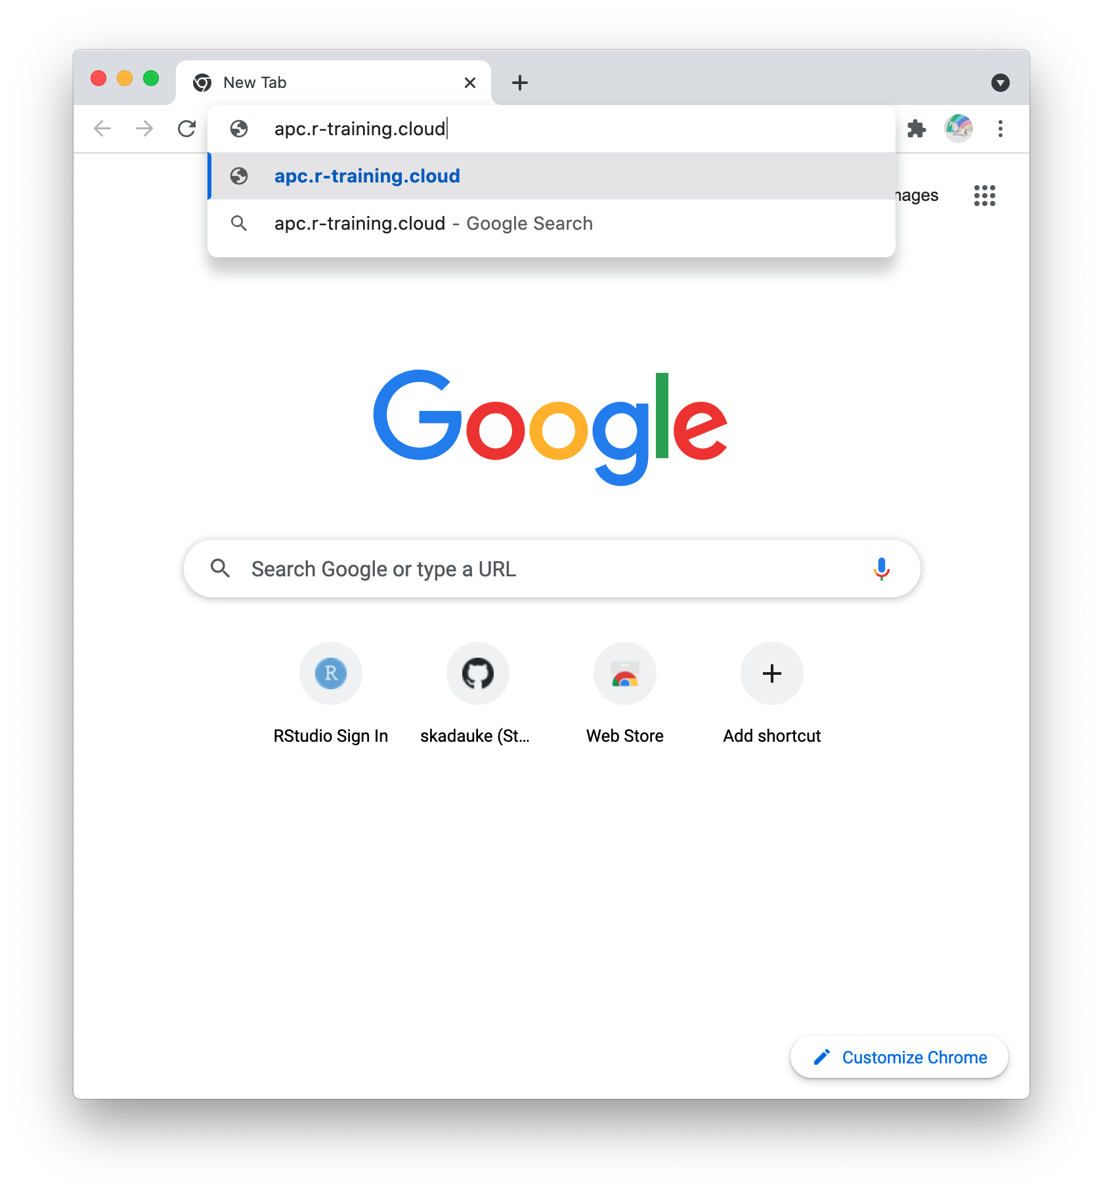
Point your browser to:
apc.r-training.cloud
Notes:
Paste into chat: https://apc.r-training.cloud

Slide 37
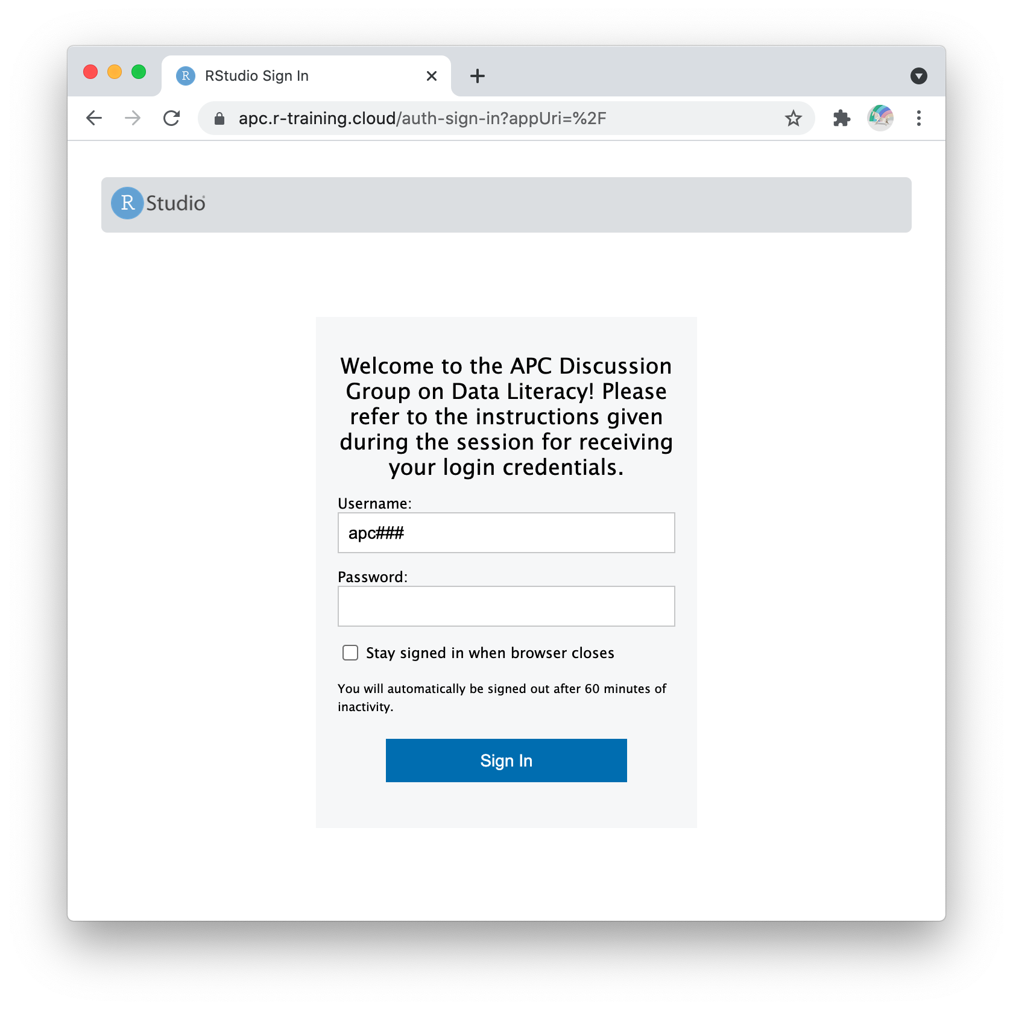
Find your login and password in the chat and enter here
Notes:
I just pasted a list of usernames and passwords in the Zoom chat. Usernames start with lower-case ‘apc’ followed by three numbers. Passwords and six digit numbers. Find the one next to your name.

Slide 38
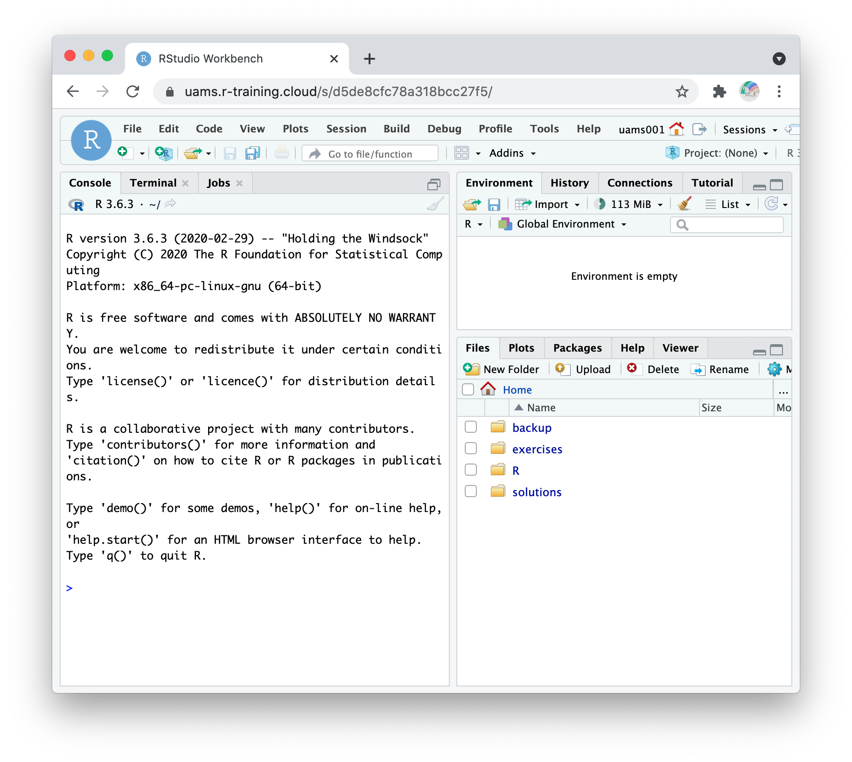
New Document

Slide 39
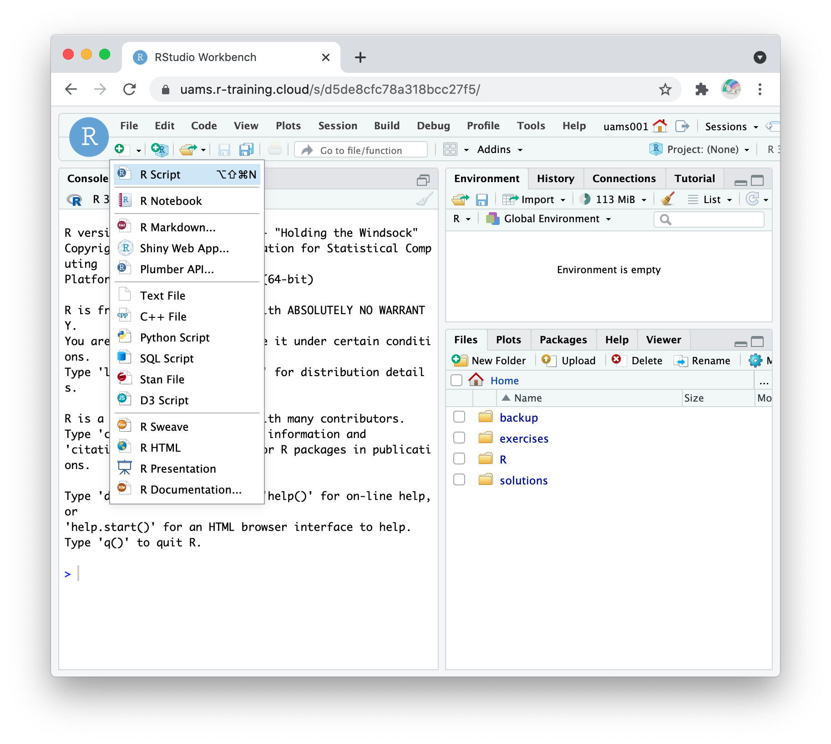
Select “R Markdown”

Slide 40
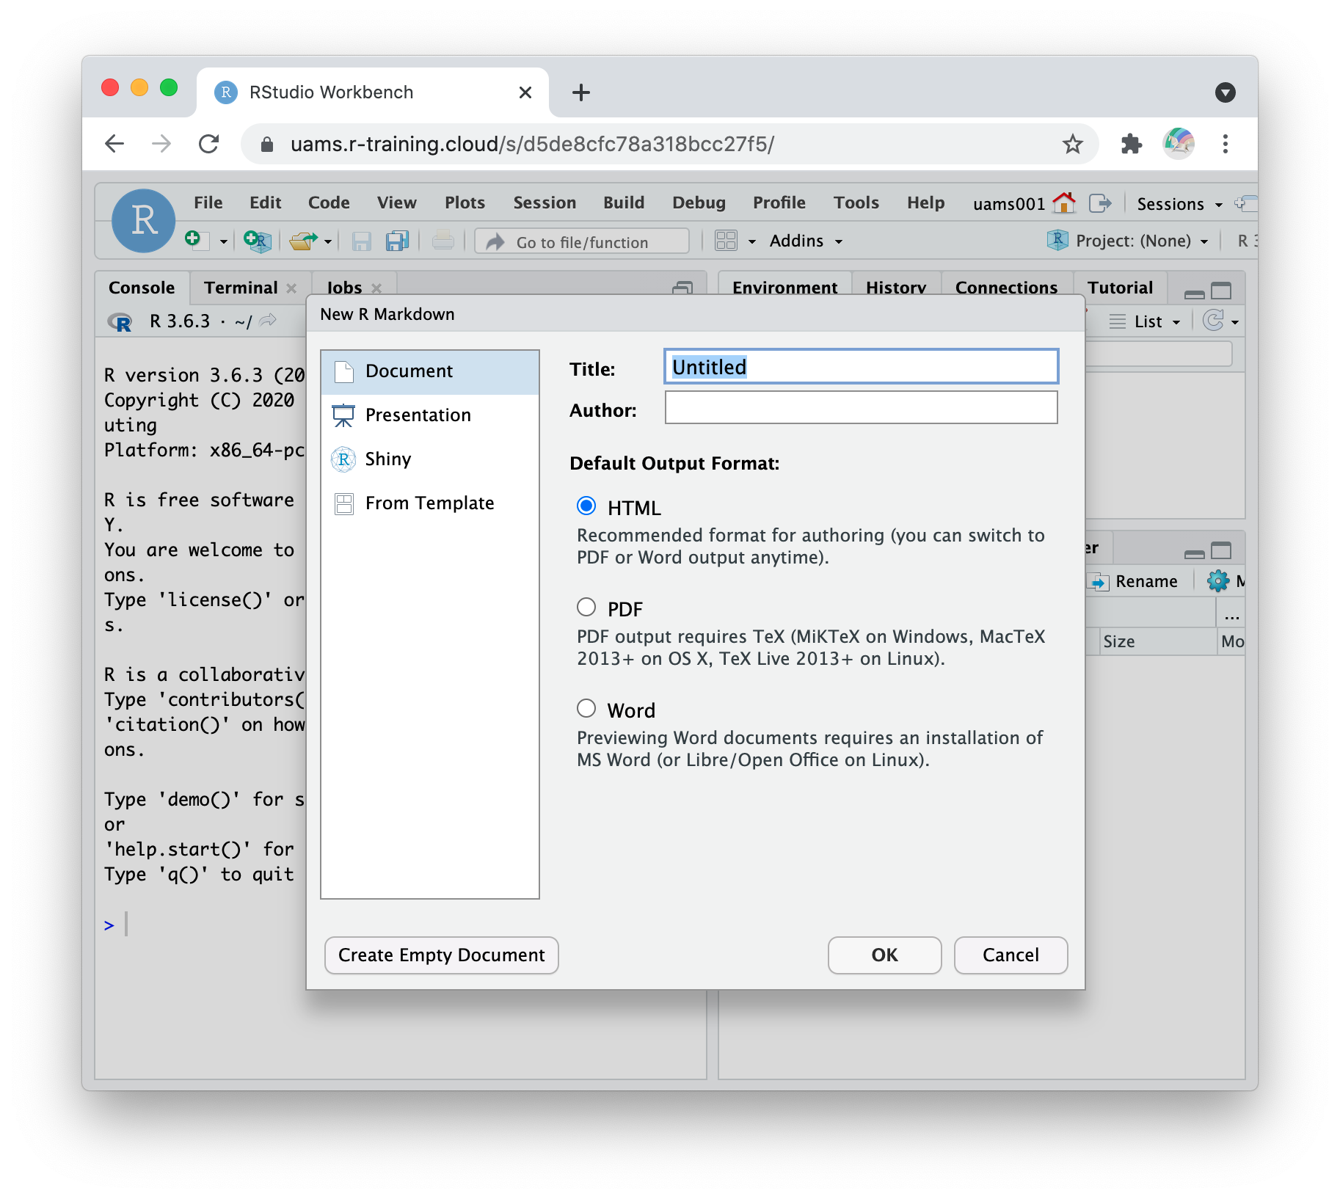
Click “OK”

Slide 41
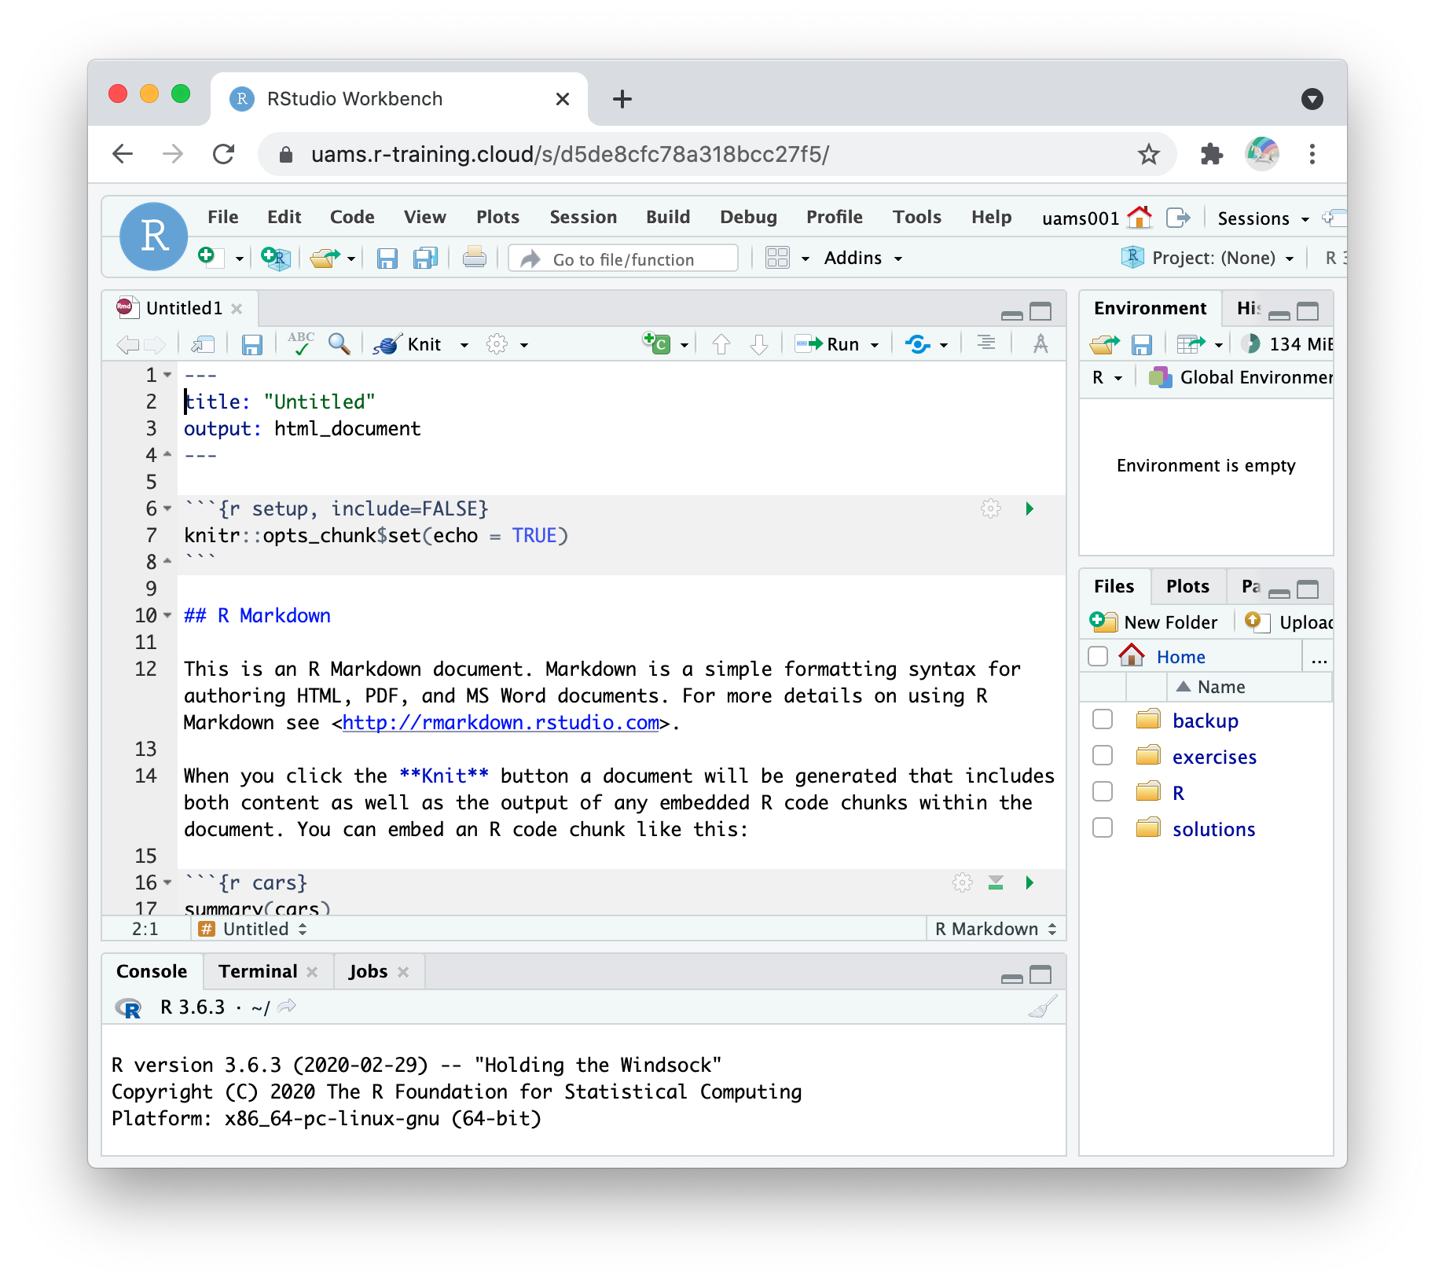
header
code chunk
Notes:
Point out two features:
(**) Header
- always at the top of the document
starts and ends with a line that has 3 dashes
Tells R Markdown what to use as the title of the document and what kind of document it is
(**) Code chunk
Always starts with 3 back ticks followed by the letter r in curly brackets
Ends with 3 backticks
RStudio editor makes it gray to make it visually distinct from the narrative text

Slide 42
Click “Knit”

Slide 43
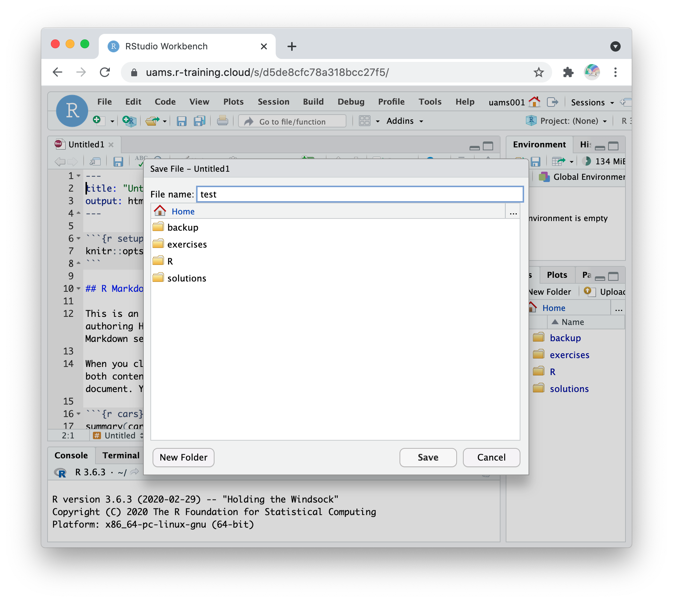
Enter any name, e.g. “test” and hit enter

Slide 44
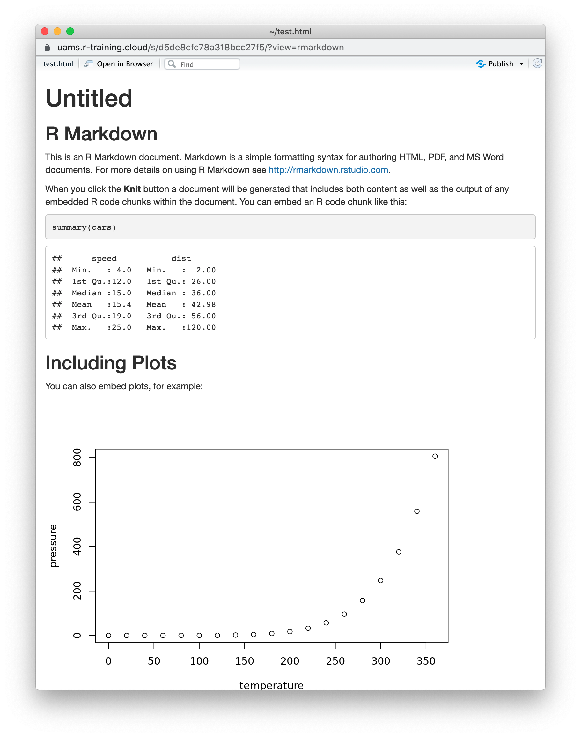
Notes:
Congrats! You knitted your first R Markdown document. (May get a message: popup disabled – try again? Yes)

Slide 45
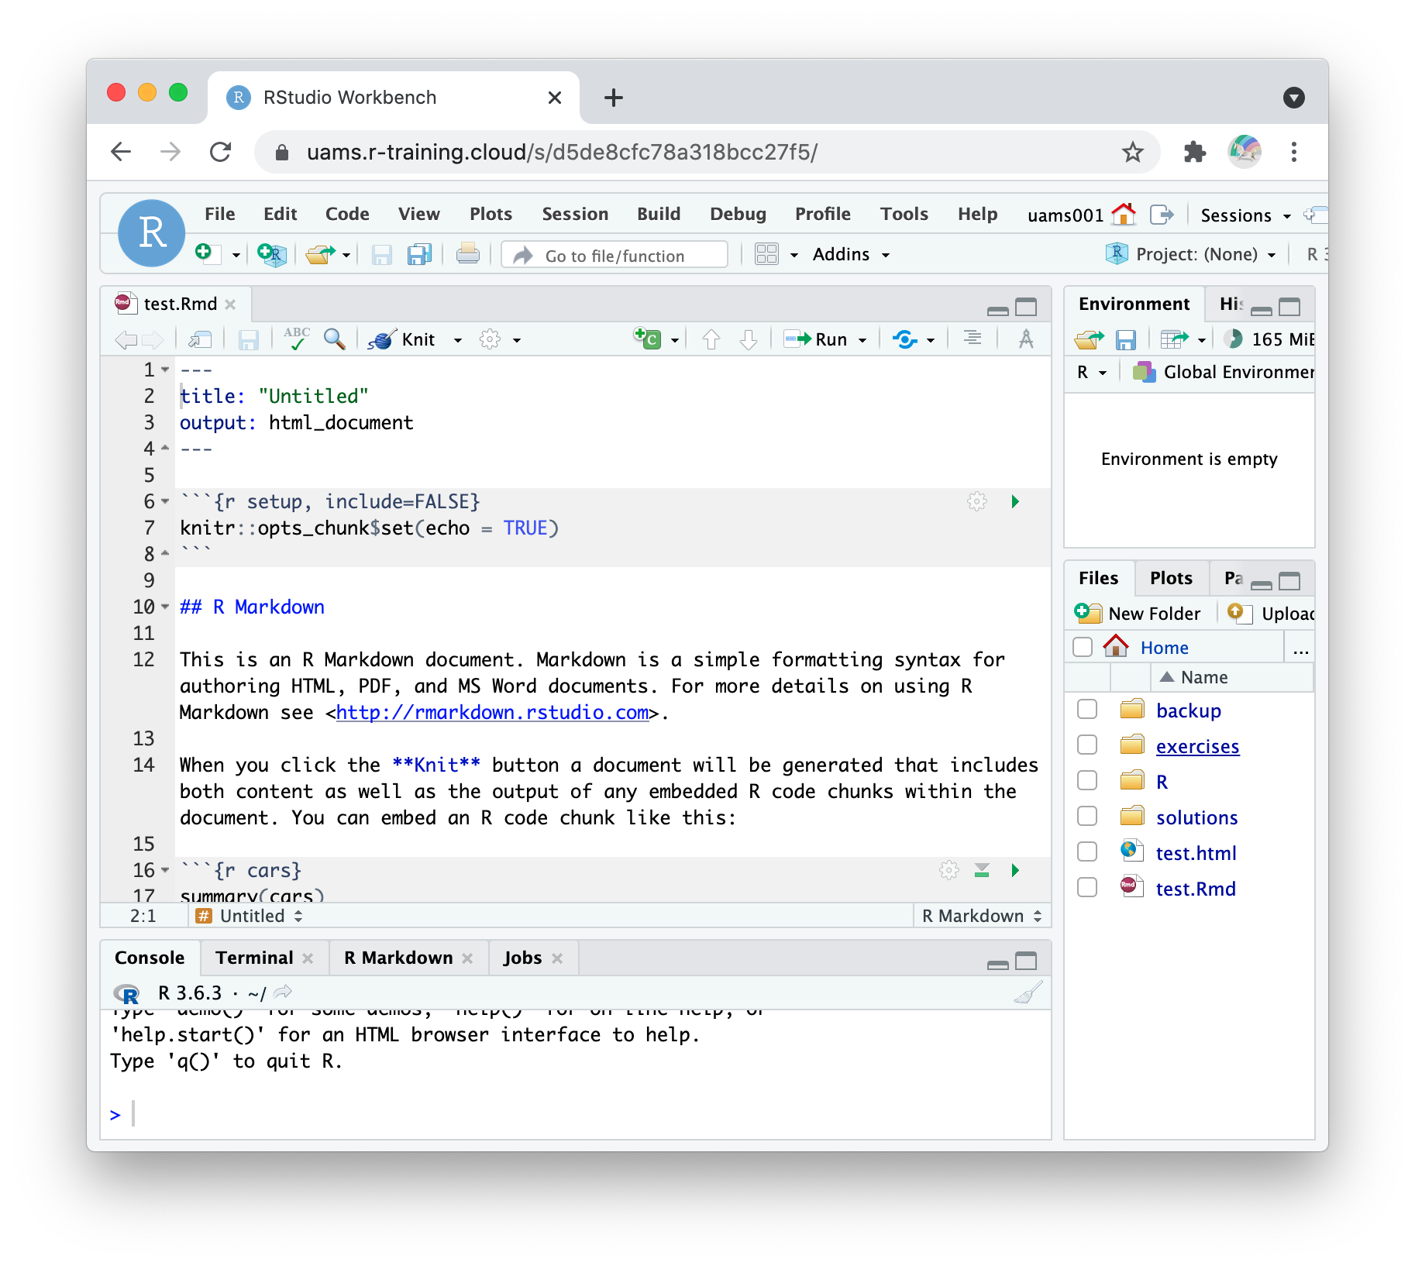
Click “exercises”

Slide 46
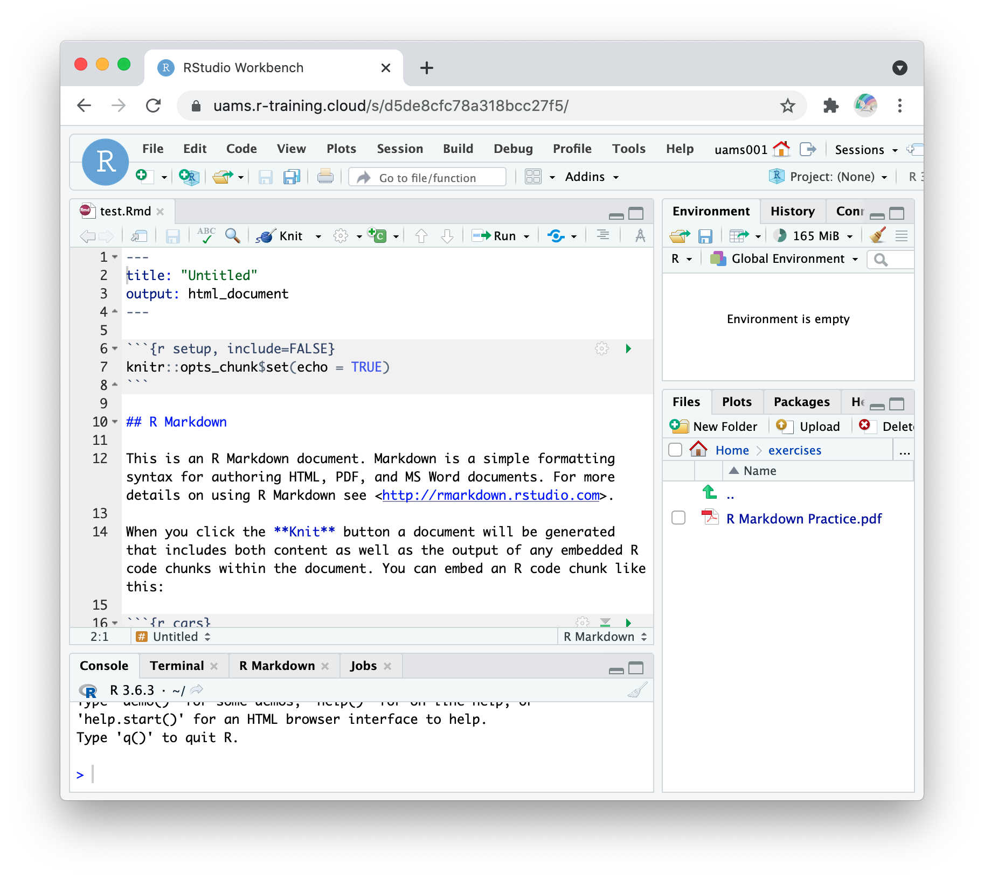
Click “R Markdown Practice.pdf”

Slide 47
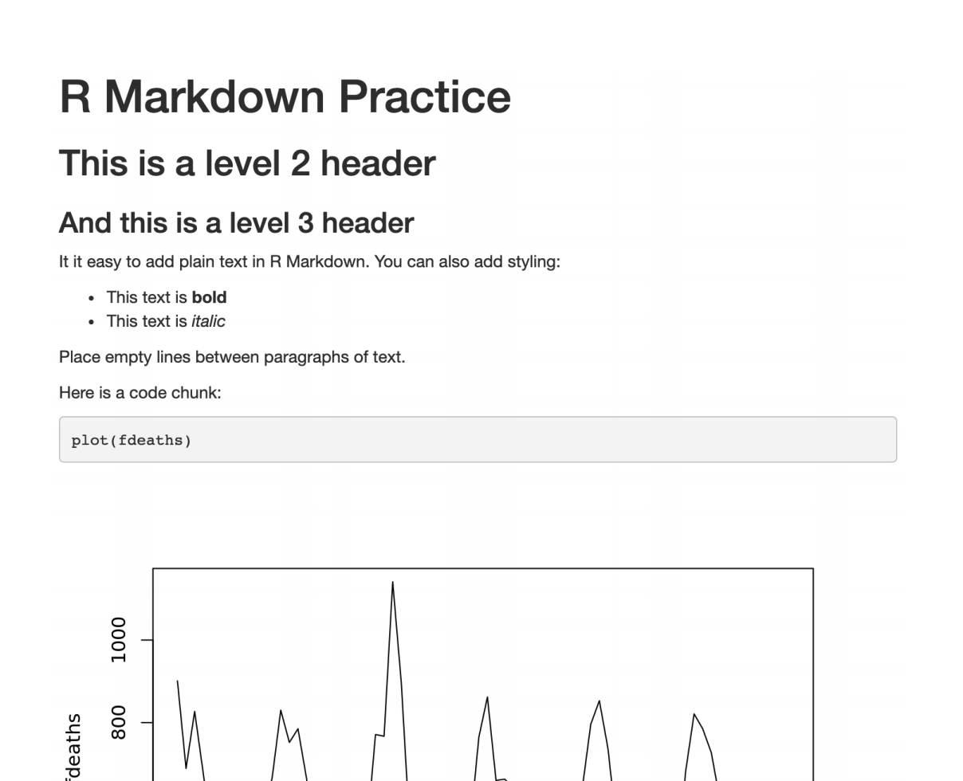
Notes:
This should open in a new browser tab…
Now, and this is going to be completely optional…
Go back to the editor, delete everything below the header, and try to re-produce this document.

Slide 48
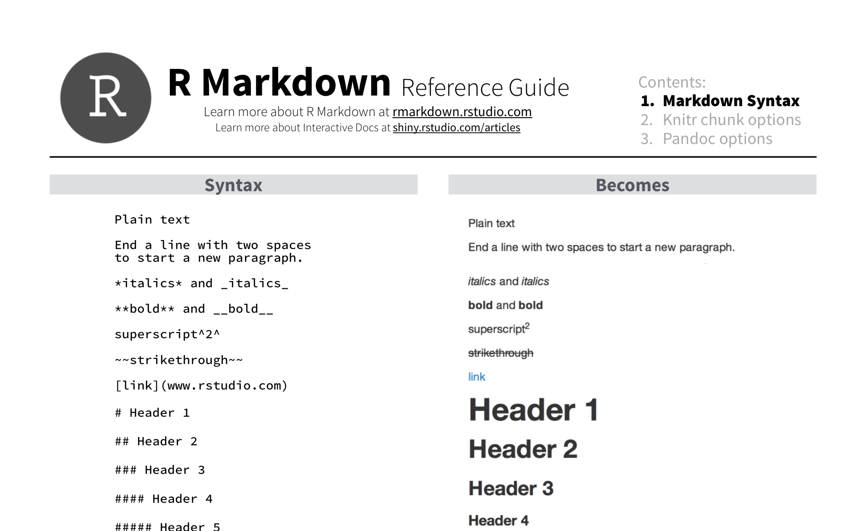
Notes:
As you do that, you might want to refer to the R Markdown Reference guide which gives you details about R Markdown syntax.
** put link into chat: https://www.rstudio.com/wp-content/uploads/2015/03/rmarkdown-reference.pdf
I just posted a link to this in the chat. And I thought I’ll give you about 5 minutes to play with this, and then I’ll go over it on my end.
** Then do a demo

Slide 49
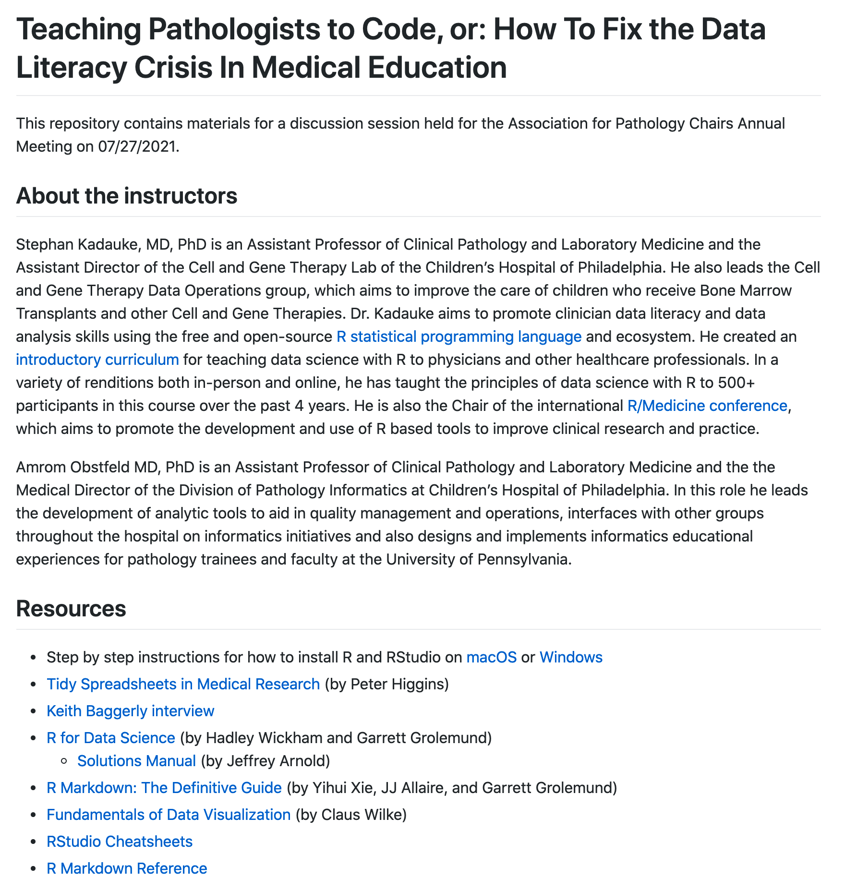
https://github.com/skadauke/apc_2021
Notes:
Also, as promised, I’m posting a link to the website I made for this lecture with has the slides and a bunch of other stuff:
** Paste: https://github.com/skadauke/apc_2021
That website will stay up forever, but the training environment will go away. But you can install R and R Markdown on your own computer if you want to learn more (and I think you SHOULD!). We have a video with step by step instructions on the website. We also have some resources on there with next steps for learning more.

Slide 50
Notes:
Baggerly paper summary
Case Study 1: doxorubicin
Sensitive / resistant label reversal (!)
Samples were duplicated, and sometimes labeled both responder and non-responder
Case study 2: cisplatin and pemetrexed
Off-by-one indexing error
Inclusion of data from other (non-reported) sources
Sensitive / resistant label reversal
Case study 3: combination therapy
Batch effect (perfect confounding of run date with treatment)
Different combination rules were used.
Case study 4: temozolomide
Wrong heatmap reported, with the wrong gene list
Case study 5: cell lines used
Sensitive / resistant label reversal is pervasive
Discussion
Common problems are simple
Confounding in experimental design
Off-by-one indexing errors – Excel (one-cell deletion with inappropriate shifting of all values in the affected column only)
Label reversal – using 0/1 instead of names
Pervasiveness of these findings when you go through the effort of forensic reconstruction: Simple problems are common.
Simple errors allow for simple fixes but poor documentation and incomplete data access hides simple errors
What should be done?
In the case of reproducibility in general, journals and funding agencies already require that raw data (e.g., CEL files) be made available. We see it as unavoidable that complete scripts will also eventually be required.

